Slide 1
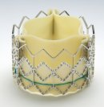
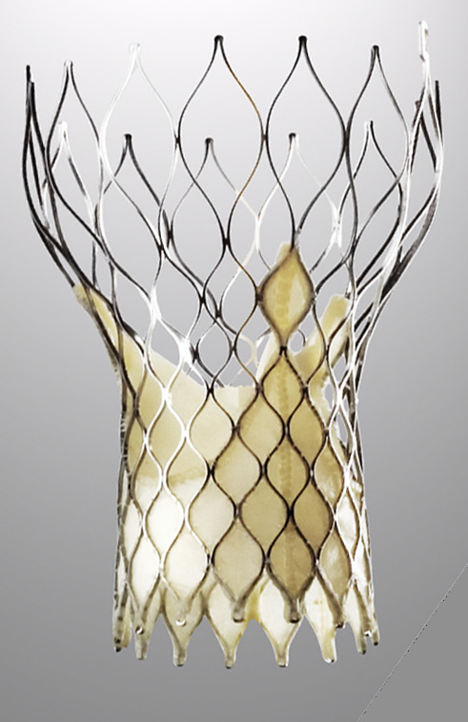


IMPLANTATION VALVULAIRE AORTIQUE PERCUTANEE
ALTERNATIVE A LA CHIRURGIE AORTIQUE CONVENTIONELLE?
Dr Gilles Lemesle
USIC et Centre Hémodynamique
CHRU de Lille

Slide 2
Généralités
les symptômes apparaissent lorsque la sténose devient serrée avec une surface < 1 cm², avec une grande variabilité individuelle
L’apparition des symptômes constitue un tournant évolutif radical avec une espérance de vie moyenne de l’ordre de:
- 2 ans si signes d’insuffisance cardiaque gauche
- 3 à 4 ans si angor ou des syncopes.
Le risque de mort subite, à juste titre redouté chez les patients symptomatiques, paraît faible, <1 % par an, en l’absence de symptômes.

Slide 3
Symptômes
Classiques :
  Dyspnée
  Angor
  Syncope ++
Moins classiques :
  Diminution des capacités fonctionnelles

Slide 4
Diagnostic Testing
Doppler echocardiography is the recommended initial test for patients with classic symptoms of AS⁷
Estimates aortic jet velocity, mean gradiant, and aortic valve area
Echocardiography is well validated and compares with cardiac catheterization
Provides information regarding LV function and coexisting abnormalities of other valves

Slide 5
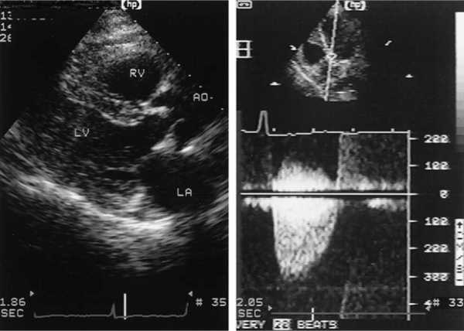

Slide 6
Classifications of Severity
 | Aortic Jet Velocity (m/s) | Mean Gradient (mm Hg) | Aortic valve Area (cm²)
Normal | < 2.5 | =4(velocity)² ^{Bernoulli’s equation} | 3 – 4 (nickel)
Mild | 2.5 – 2.9 | < 25 | 1.5 – 2
Moderate | 3 – 4 | 25 – 40 | 1 – 1.5 (golf tee)
Severe | > 4 | > 40 | < 1 0.6 cm²/m²

Slide 7
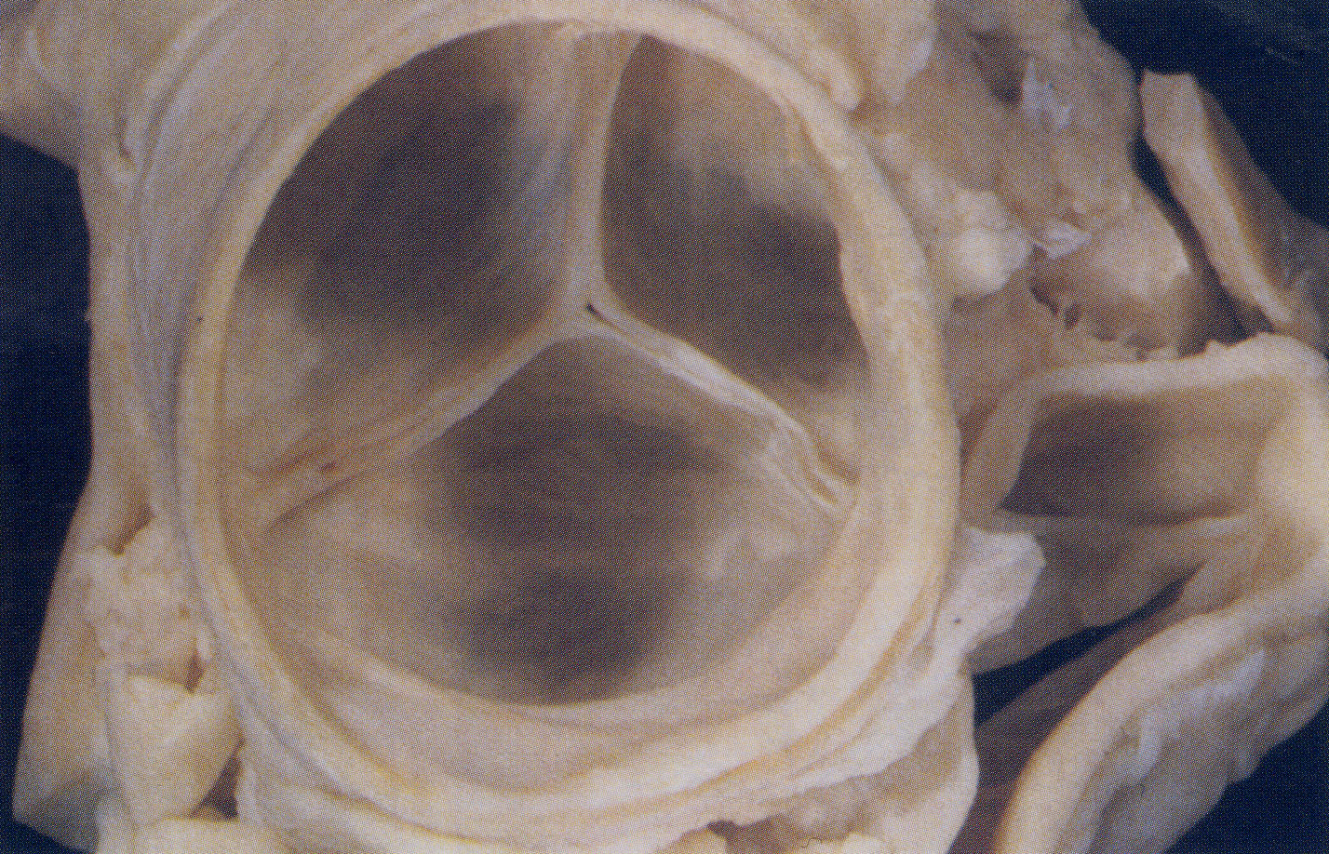
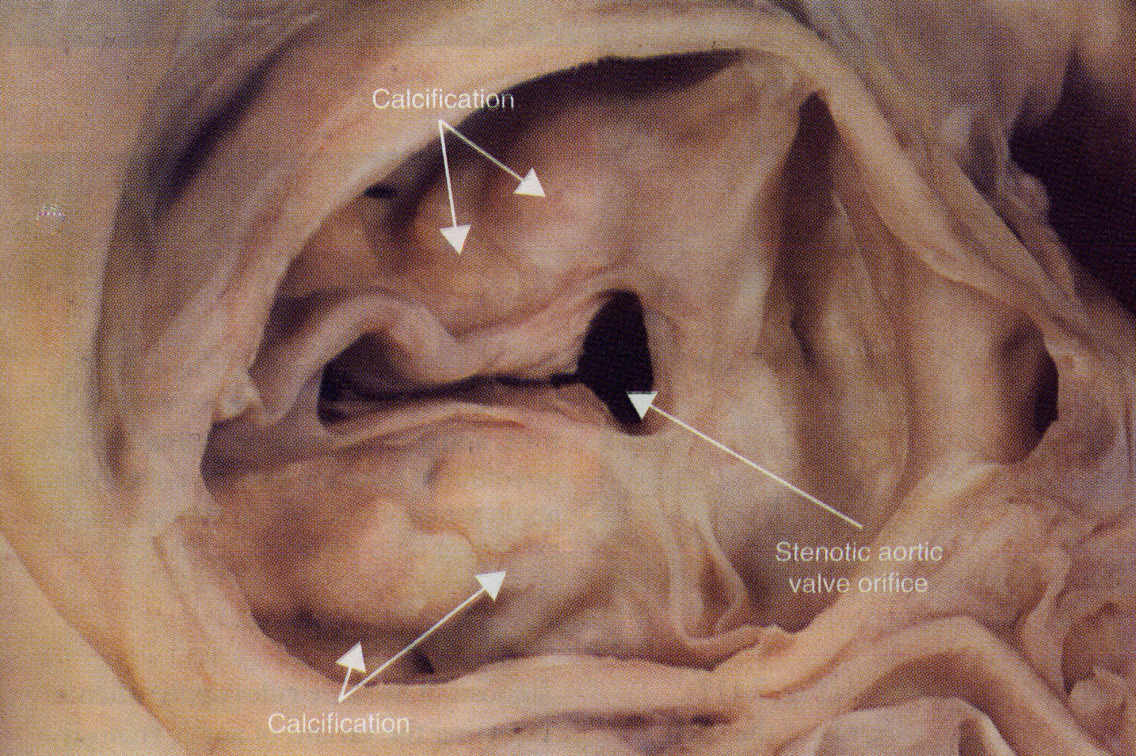
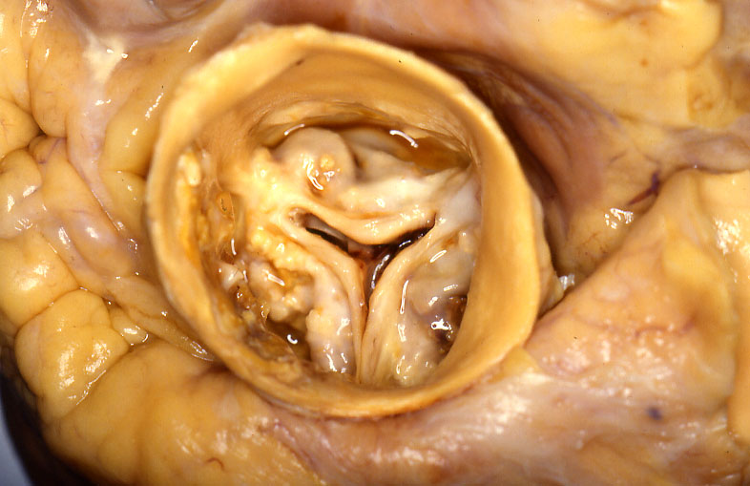
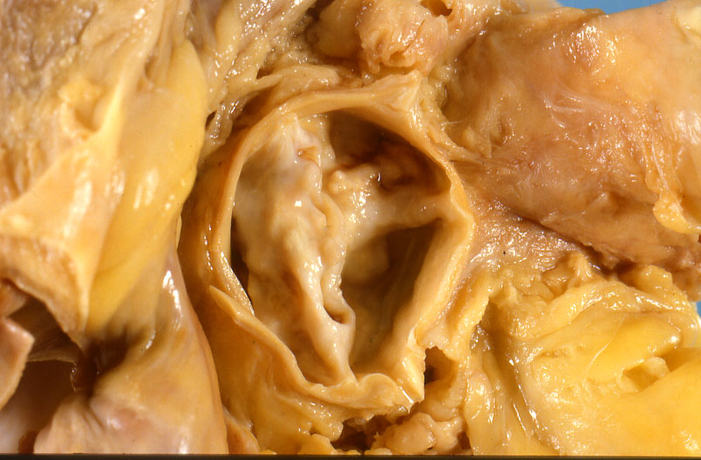
Rétrécissement aortique
Causes – Anomalie congénitale, RAA, diabète, calcificationset dégénérescence.

Slide 8
Comment traiter un RAC?
Traitement médical?
Remplacement chirurgical
Valvuloplastie percutanée

Slide 9
Traitement
Aucune efficacité du traitement médical du RAO

Slide 10
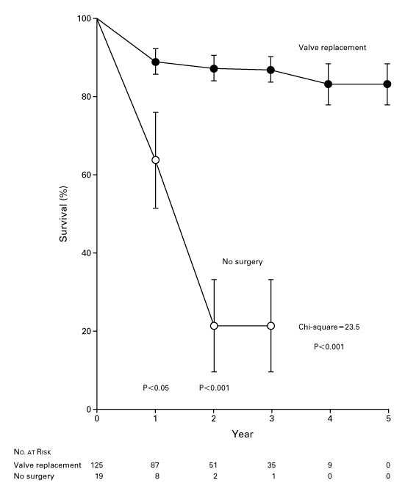
Survival among Patients with Severe Symptomatic Aortic Stenosis Who Underwent Valve Replacement and Similar Patients Who Declined to Undergo Surgery¹⁰
Valve Replacement
No Surgery

Slide 11
Comment traiter un RAC?
Traitement médical?
Remplacement chirurgical
Valvuloplastie percutanée

Slide 12
Treatment
10-year survival rate after aortic valve replacement almost identical to that in age- and sex-matched persons¹¹
Well-accepted recommendation that aortic valve replacement should be performed promptly in symptomatic patients⁷

Slide 13
Traitement chirurgical
Mortalité peri opératoire moyenne 4%⁸ (dépend Euroscore +++)
Risque d’anomalie de la prothèse de 1% / an⁹
  Prothèses mécaniques
    Longévité mais anticoagulation (INR 2-3)
  Prothèses biologiques
    Bioprothèses
    Allogreffe/homogreffe
    Intervention de Ross

Slide 14
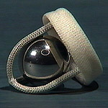
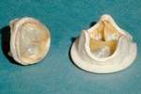
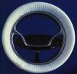
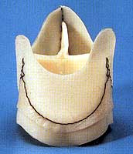
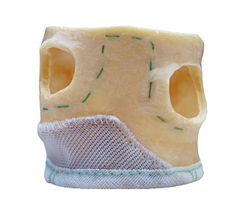

Prothèses

Slide 15
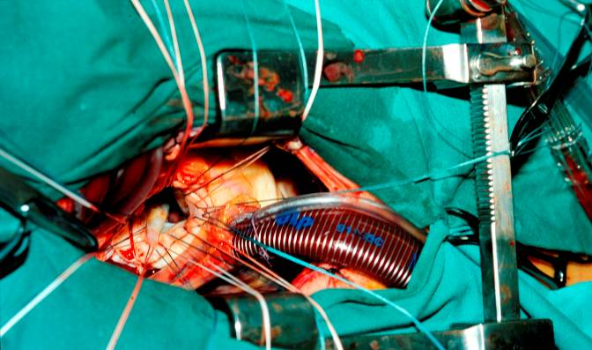
Remplacement valvulaire aortique par mini-thoracotomie
Aortic Valve Replacement Through a Minimally Invasive Approach: Preoperative Planning, Surgical Technique, and Outcome Andre Plass et al. Clinic for Cardiovascular Surgery, Institute of Diagnostic Radiology, and Cardiovascular Center, University Hospital Zurich. ATS 2009
Minimally Invasive Versus Standard Approach Aortic Valve Replacement: A Study in 506 Patients
Ihsan Bakir et al. Cardiovascular and Thoracic Surgery Department, OLV Clinic, Aalst, Belgium; ATS 2006

Slide 16
Comment traiter un RAC?
Traitement médical?
Remplacement chirurgical
Valvuloplastie percutanée

Slide 17
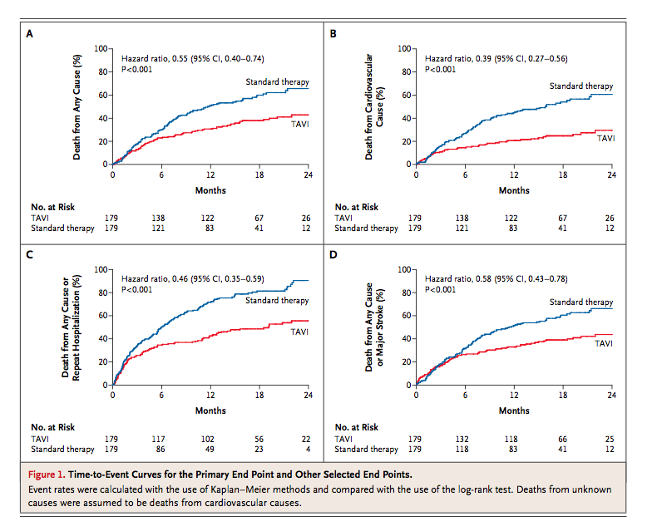

Slide 18
Changement de pratique
Chirurgien cardiaque = endovasculaire
Cardiologue= gestion des complications vasculaires et traumatisme cardiaque
Collaboration : anesthésiste+ cardiologue + chirurgien
Recrutement:
Généraliste
Cardiologue
Chirurgien

Slide 19
Valvular heart disease in the community:
European experience.
Iung B, Baron G, Tornos P, Gohlke-Bärwolf C, Butchart EG, Vahanian A
The Euro Heart Survey on valvular heart disease included 5001 patients from 92 centers in 25 European countries in 2001.
Analysis of the therapeutic decision in patients with severe valve diseases showed that symptomatic patients were frequently denied surgery (32.3% in AS after the age of 75 and 51.3% in MR), more on the basis of age and left ventricular function than comorbidities. These findings underline the need for better implementation of guidelines.

Slide 20
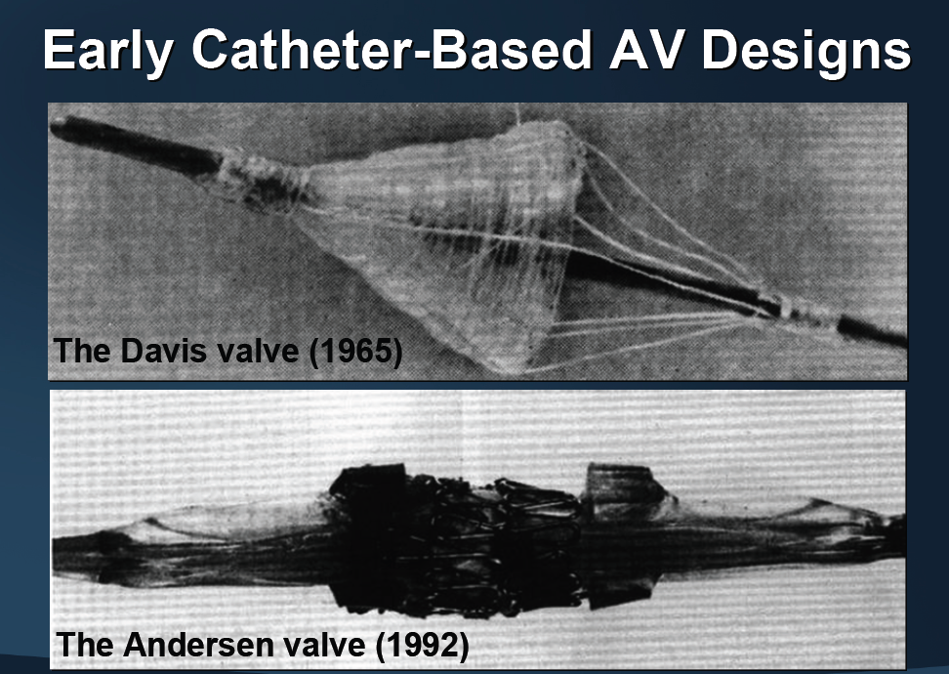
THE PAST

Slide 21
Valves aortiques percutanées
Cribier-Edwards
CoreValve

Slide 22
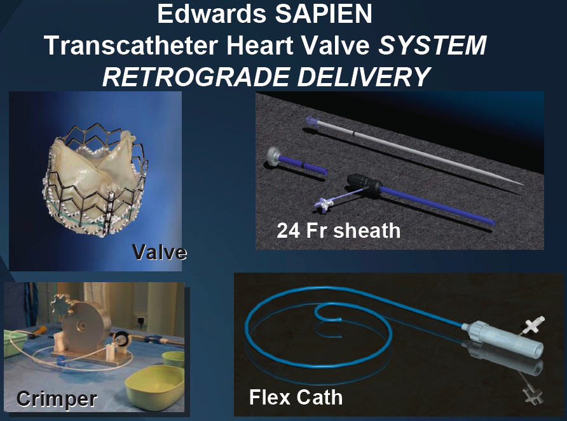
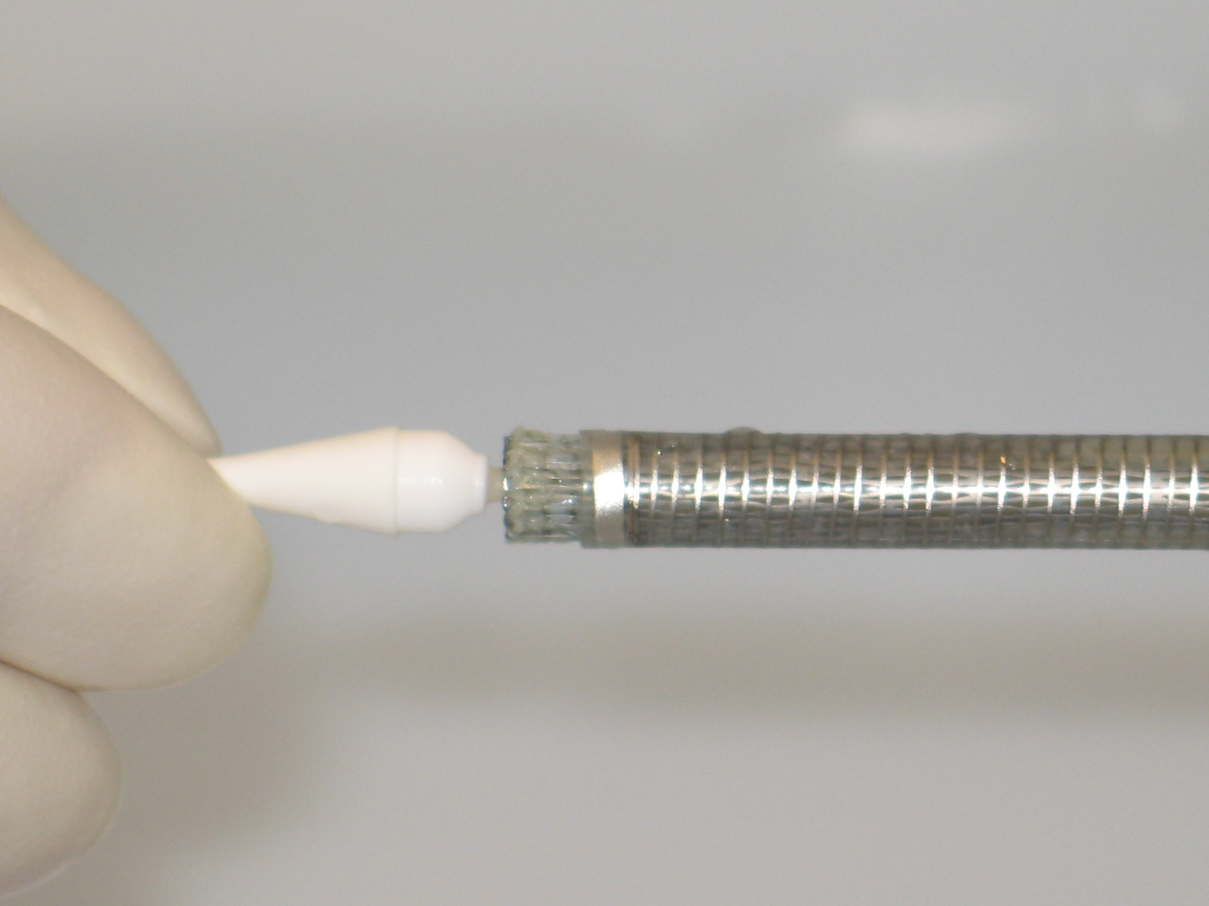
Loading must take place while submersed in cold saline.

Slide 23
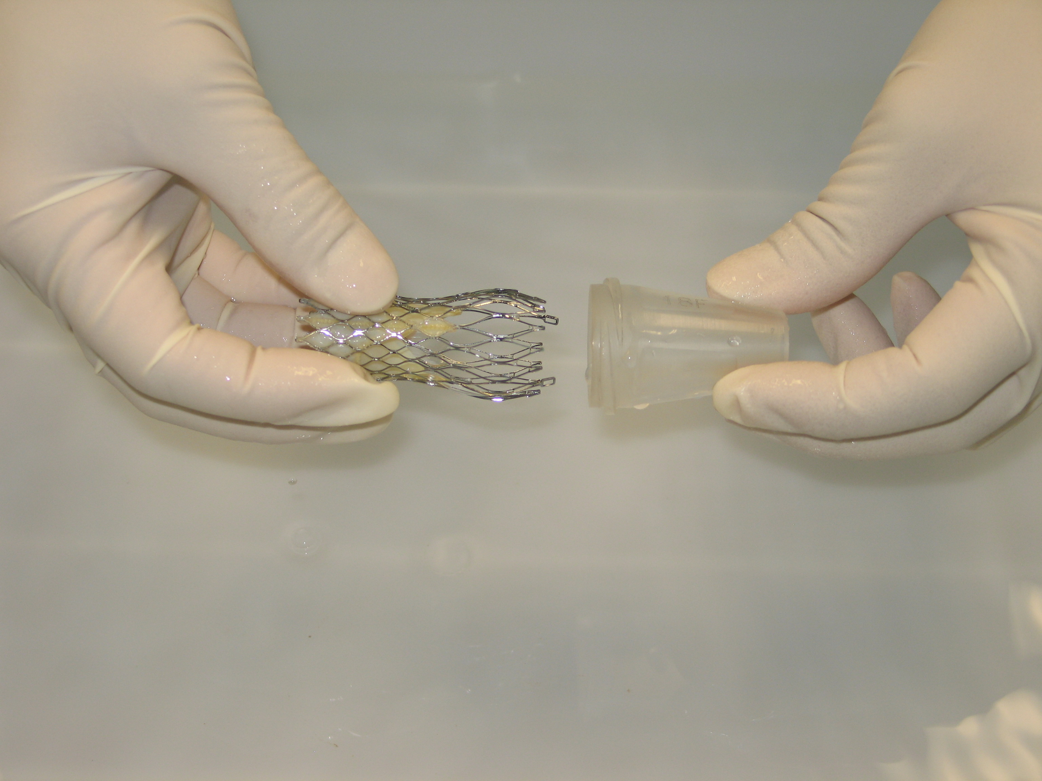
Gently squeeze the outflow part of the cold bioprosthesis frame and insert into outflow cone.
Loading must take place while submersed in cold saline.

Slide 24
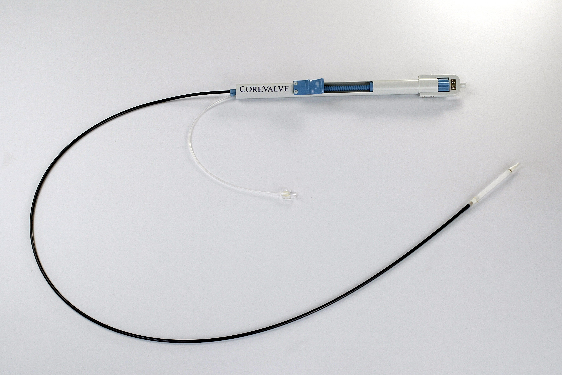
CoreValve Delivery Catheter
Over-the-wire (0.035” compatible)
Radiopaque tip
18Fr Valve capsule
12Fr Flexible shaft
Radiopaque marker
Notes:
THE COREVALVE DELIVERY CATHETER SYSTEM (DCS) IS AN OVER-THE-WIRE CATHETER, WHICH CAN ACCOMMODATE A GUIDEWIRE UP TO 0.035” IN DIAMETER. THE DISTAL PART OF THE CATHETER CARRIES THE PROSTHESIS AND DELIVERS IT TO THE DEPLOYMENT SITE. IT INCORPORATES FLEXIBILITY, TRACKABILITY AND RIGIDITY REQUIRED TO NAVIGATE TO THE AORTIC ANNULUS AND HAS AN INTEGRAL HANDLE FOR PRECISE CONTROL OF DELIVERY OF THE BIOPROSTHESIS.

Slide 25
Submerge catheter tip into cold saline and flush distal luer-lock connection on handle.
Loading must take place while submersed in cold saline.

Slide 26
PARTNER Study Design
Symptomatic Severe Aortic Stenosis
ASSESSMENT: High-Risk AVR Candidate
3,105 Total Patients Screened
Total = 1,057 patients
N = 699
High Risk
Inoperable
N = 358
2 Parallel Trials:
Individually Powered
Yes
ASSESSMENT: Transfemoral Access
No
ASSESSMENT: Transfemoral Access
Transfemoral (TF)
Transapical (TA)
Yes
No
1:1 Randomization
1:1 Randomization
1:1 Randomization
Not In Study
N = 244
N = 248
N = 104
N = 103
N = 179
N = 179
TF TAVR
AVR
TA TAVR
AVR
TF TAVR
Standard
Therapy
VS
VS
VS
Primary Endpoint: All-Cause Mortality at 1 yr
(Non-inferiority)
Primary Endpoint: All-Cause Mortality
Over Length of Trial (Superiority)
Co-Primary Endpoint: Composite of All-Cause Mortality
and Repeat Hospitalization (Superiority)

Slide 27

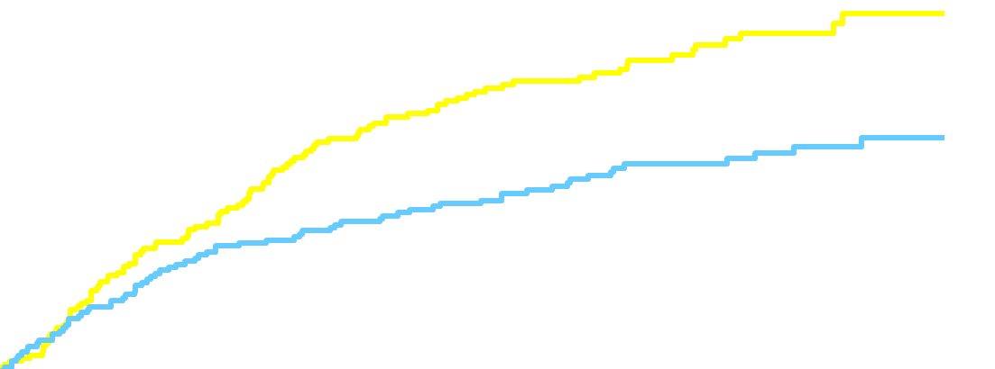
Inoperable PARTNER Cohort
Primary Endpoint: All-Cause Mortality
  HR [95% CI] =
  0.54 [0.38, 0.78]
  P (log rank) < 0.0001
Standard Rx
TAVI
  ∆ at 1 yr = 20.0%
  NNT = 5.0 pts
50.7%
All-cause mortality (%)
30.7%
Leon et al, NEJM 2010; 363:1597-1607
Months
Numbers at Risk
TAVI | 179 | 138 | 122 | 67 | 26
Standard Rx | 179 | 121 | 83 | 41 | 12
Notes:
27

Slide 28
Operable patient, Primary Endpoint:
All-Cause Mortality at 1 Year
0.5
  HR [95% CI] =
  0.93 [0.71, 1.22]
  P (log rank) = 0.62
TAVR
AVR
0.4
26.8
0.3
0.2
24.2
0.1
0
0
6
12
18
24
No. at Risk
Months
348 | 298 | 260 | 147 | 67
351 | 252 | 236 | 139 | 65
TAVR
AVR

Slide 29
Indications
Existence d'une sténose aortique sénile dégénérative
avec un gradient moyen supérieur à 40 mm Hg et/ou une vélocité supérieure à 4 m/sec ou une surface valvulaire initiale inférieure à 1 cm2 (index < 0,6 cm2)
- symptômes liés au rétrécissement aortique
NYHA ≥ 2, ou classe 1 avec dysfonction ventriculaire (fraction d’éjection ventriculaire gauche (FEVG) < 40 %)
- un Logistic Euroscore ≥ à 20 % et/ou un STS Risk Calculator supérieur ou égal à 10
Dans le cas où ces valeurs sont inférieures, la confirmation des comorbidités non prises en compte par ces indices devra être produite collégialement par l’équipe.

Slide 30
Indications
En l’état actuel du développement de la technologie, l’implantation d’une valve par voie transfémorale ou transapicale est indiquée chez les patients symptomatiques avec sténose aortique sévère calcifiée, sélectionnés suite à une décision collégiale faisant intervenir 4 médecins (cardiologue non interventionnel, cardiologue interventionnel, chirurgien cardiaque, et anesthésiste).
Deux sous-populations sont distinguées :
- les patients contre-indiqués à la chirurgie conventionnelle ;
- les patients à haut risque chirurgical

Slide 31
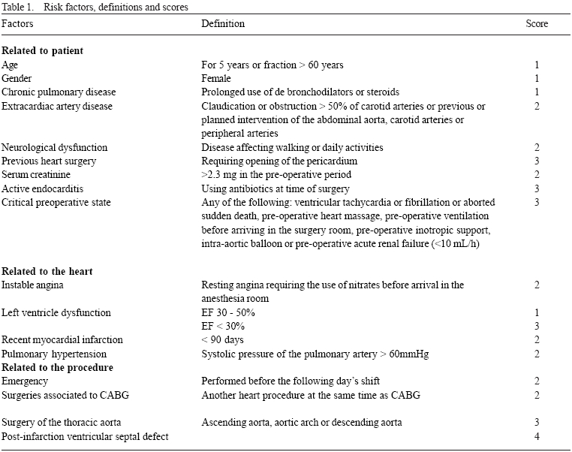
Euroscore

Slide 32
INDICATIONS
Native Aortic Valve Disease
Severe AS: AVAI ≤0.6 cm²/m²
27mm ≥AV annulus ≥20mm
Age ≥ 80y
Logistic EuroSCORE
≥ 15% (20%)
Young patients
Liver cirrhosis (Child A or B)
Pulmonary insufficiency: FEV1<1L
Previous cardiac surgery
PHT (PAP>60mmHg)
Recurrent PE’s
RV failure
Hostile thorax (radiation, burns,etc)
Severe connective tissue disease
Cachexia
High risk and inoperable patients with severe AS
Learning curve cases at new sites

Slide 33
Bilan d’Eligibilté

Slide 34
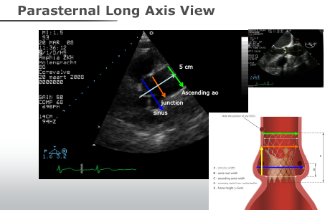

Slide 35
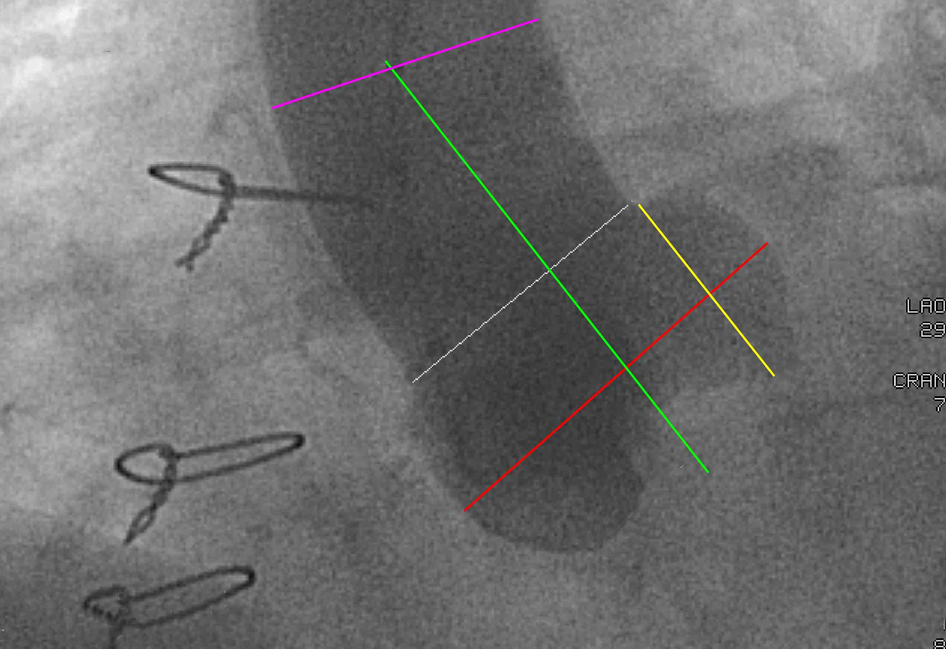
Angio of Aortic Root
5 cm
Ascending AO
STJ
sinus
Sinus height
Diamètre
Calcification
Athéromatose
Angulation

Slide 36
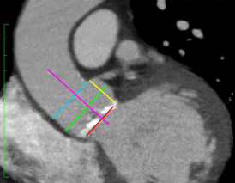
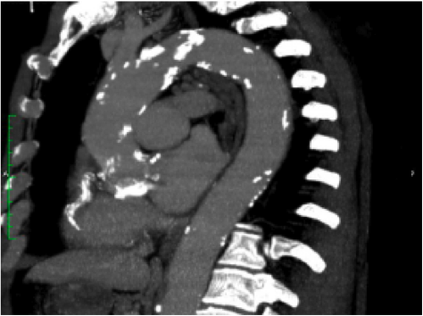
CT reconstruction of Aortic root
height

Slide 37
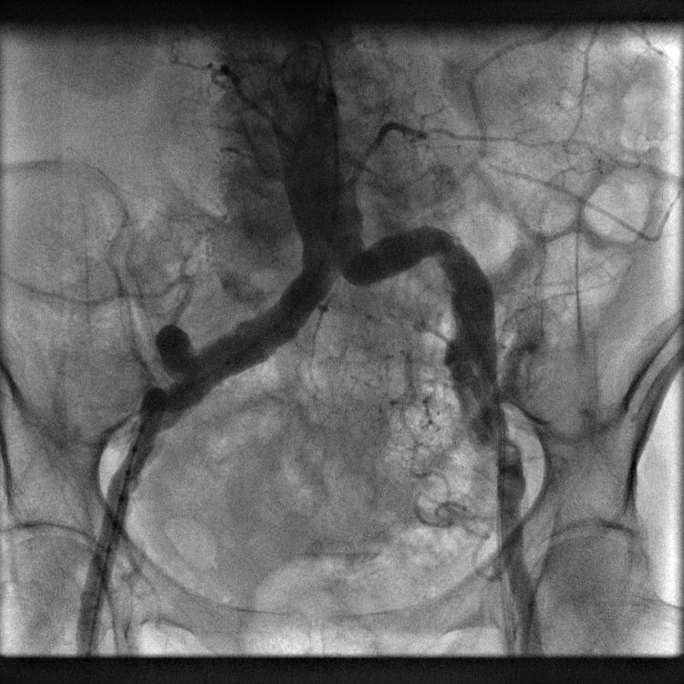
Selection de patient
TAVI Trans-fémorale
a) contre-indiqué
b) à risque
Calcifiée +
Tortueuse ++
Diamètre = 6.0 mm
Notes:
Subclavian approach is a good alternative
Of course when peripheral femoral access is contraindicated if total occlusion of the abdominal aorta for exemple but is also to be considered in a feasible but unsafe anatomical situation as in this case where the femoral vessels are tortuous, moderately calcified and limit in diameter

Slide 38
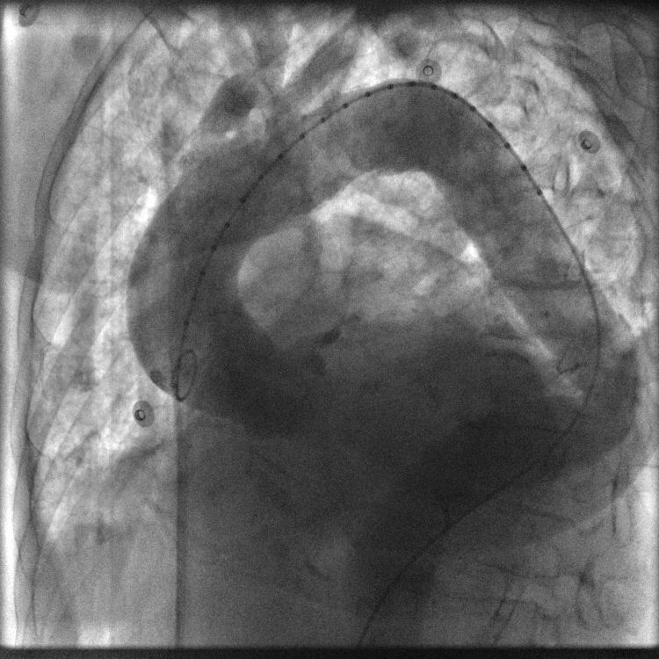
Angio-Aortographie
Feasibility & Safety
Calcifications +
Tortuosités ++

Slide 39
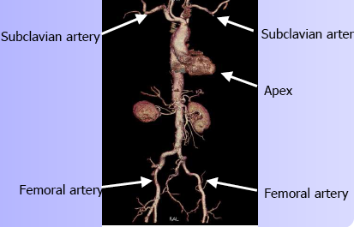
Voies d’accés
Transfémorale: percutanée, mini abord.
Voie sous clavière
Transapical: thoracotomie gauche

Slide 40
Voie sous-clavière = alternative
Vs Transapicale
Mitigates or eliminates trauma to the heart
Recovery time is faster and lower risk (drainage ports are not needed)
Vs Transfémorale
Bypasses aortic arch
Not limited by femoral vasculature
Able to visually control closure
Better control of delivery catheter and guidewire

Slide 41
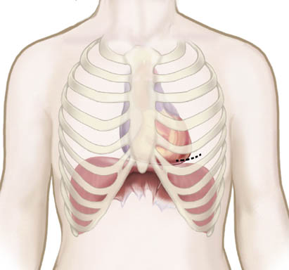
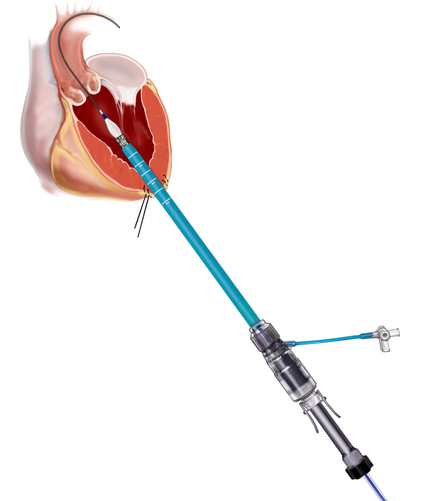
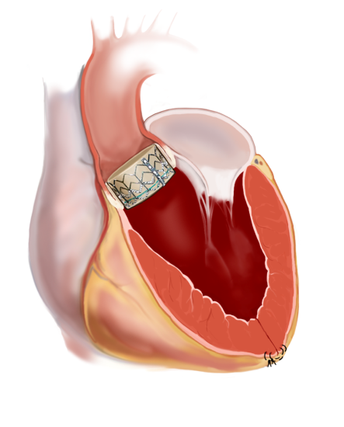
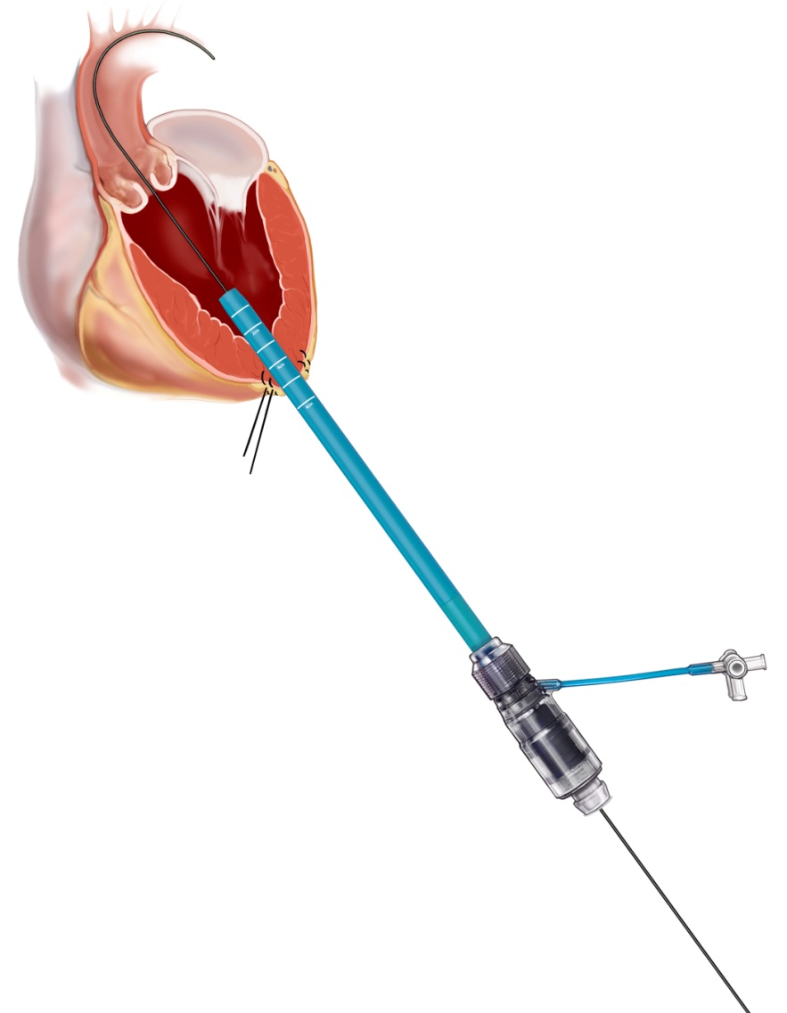
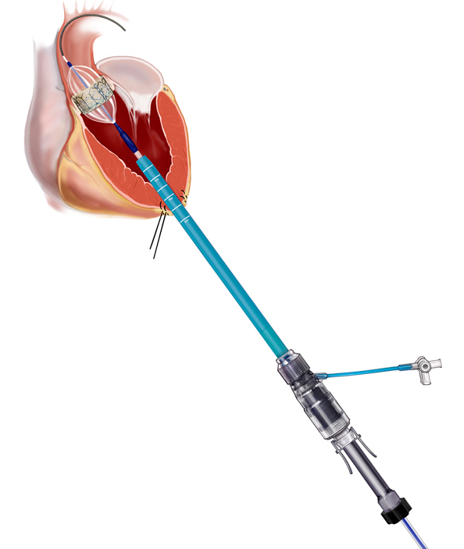
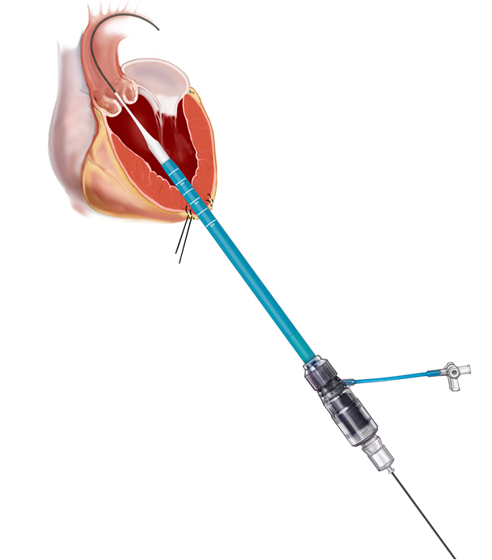
Voie trans apicale = alternative
Edwards SAPIEN™ Transcatheter Heart Valve
Transapical Approach
Anterior mini-thoracotomy
Guidewire and Sheath Introducer insertion
Balloon Aortic Valvuloplasty
Valve Placement
Final Position

